Slide 1
CONFLICTS *Introduction to Conflicts and negotiation *Approaches/ Views of Conflict Management (Session: 1-5)
Reference Material: T2 Chapter 3, T3 Introduction section
Compiled by Dr. Renu Girotra

Slide 2
Overview Introduction to Conflicts and negotiation
What is conflict?
Where is conflict?
Are all conflicts bad? - destructive and constructive conflict
Sources of conflict
What is Negotiation?
Why negotiation?

Slide 3
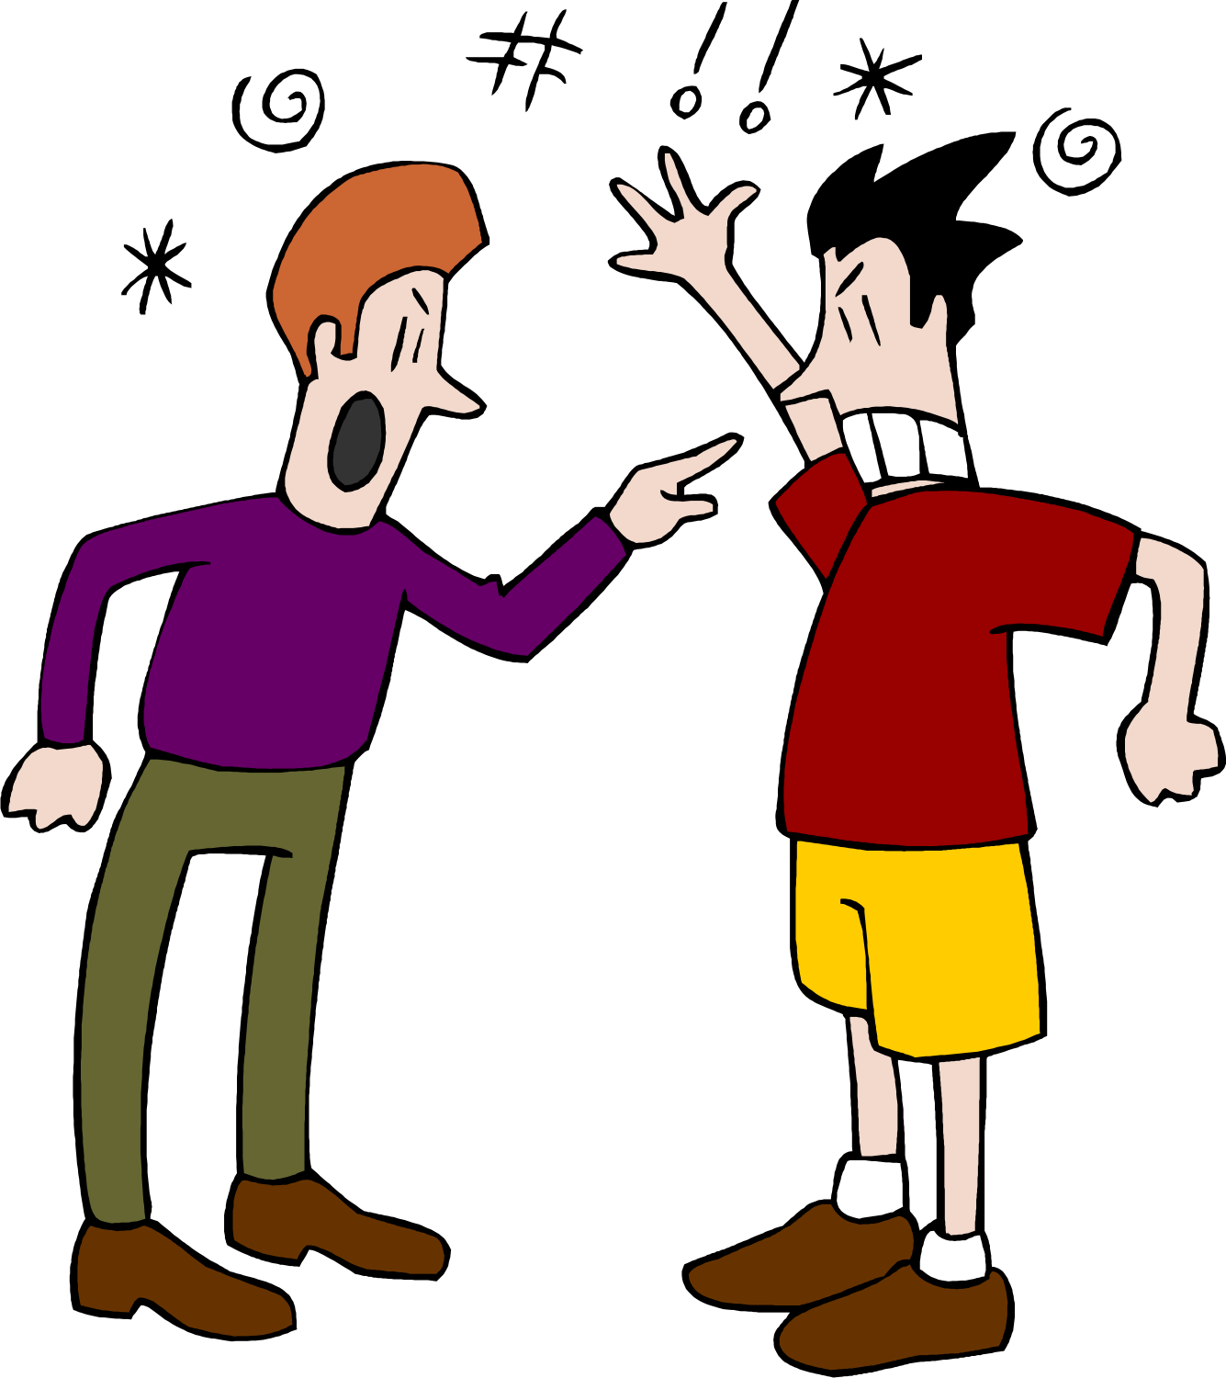


Where is conflict

Slide 4
Approach: Conflict
Positive Approach
Strengthening
Developmental Growth
Courageous
Helpful
Exciting
Stimulating
Creative
Energizing
Clarifying
Enriching
Good
Negative Approach
Destructive
Pain
War
Hostility
Threat
Violence
Competition
Anger
Distress
Alienation
Hopeless
Bad

Slide 5
Conflict??
Incompatibility of cognitions or emotions within individuals or between individuals (people / groups / nations.....)
(Conflict may be real or perceived)
The keys for purposes of developing negotiation skills are about understanding:
Interdependence (no interdependence, no negotiation)
Perception (underscore perceptions)
Mutuality (No potential of benefit to self, no negotiation)

Slide 6
Approach: Negotiation
Positive Approach:
Interaction
Mutual benefit
Interdependence
Opportunity
Difference
Exchange
Persuade
Exciting
Stimulating
Challenging
Negative Approach
Contest
Win or lose
Control
Problem
Dispute
Struggle
Manipulate
Frightening
Tension
Difficult

Slide 7


Are conflicts bad? (Constructive and Destructive conflicts)
Destructive
Constructive
negative, avoidant, or competitive approach or attitude is often destructive
Destructive patterns may result in missed opportunities, frustration of goals, and other personal negative repercussions.
In organizational contexts, negative repercussions may include lower productivity, lower morale, increased destructive political behavior, reduced cohesion, absenteeism, and turnover
Unless mismanaged, produces valuable additional information as well as multiple minds for analyses.
Produces well-thought-out decisions with knowledge of impact.
Fosters creativity
Aids in consensus and integration
Leads to achievement of common organizational goals

Slide 8
Sources of Conflict (usually Socio-psychological in nature)
Cooperation-competition.
Social justice
Motivation
Trust
Communication
Language
Attribution processes
Emotions
Persuasion
Self-control
Power
Violence
Intergroup conflict
Moral conflict
Judgmental bias (misunderstanding, perceptions, culture, gender, ethnicity, religious etc.)
Intractable conflicts (Difficult, long-standing conflicts)

Slide 9
Schools of Thought:
Traditional View
conflict is bad and should be avoided
fosters both avoidance and competitive behavior in interaction.
Human Relations view
Interactionist
A natural phenomenon
Considers sometimes functional and other times dysfunctional
can be a mechanism through which views and opinions are made known, and through which an opportunity for creativity and persuasion is born
can also increase communication and integration
conflict is inevitable
maintaining and managing a certain degree of it can actually be helpful
Embrace it
conflict as a positive force except when it is misdiagnosed, improperly avoided, or mismanaged.
Key in resolving conflict is : correct diagnosis, and correct strategy and action

Slide 10
Theories
Sociological Theories
emphasize that conflict is both inevitable and necessary for the continued existence of a social group
conflict serves a communication function that can aid in consensus and integration
Also focus on power and domination in social structures
Suggests understanding and managing the constructive, positive effects of conflict
Also suggests understanding, avoiding, and/or resolving destructive conflict
Conflict unconfronted may lead to partial or complete disintegration or undesirable change through subversive acts or open demonstration of hostilities
Chaos and Complexity theories
behavior may develop into a system or patterns
System may have
visible structure (competitive / avoidant /collaborative)
invisible structure
will come to a functioning level, whether or not such level is optimal or desired
Feedback can produce growth or chaos (complexity theory refers to feedback as a recursive loop)
Systems Approach
combination of communication systems theory, conflict theory, critical theory, chaos theory, and symbolic interactionism
systems approach and perspective to conflict diagnosis and negotiation strategizing
System can create and sustain conflict
Assume self-correcting phenomena
Analysis of a cause and effect relationship (not whole as a sum of all)
Systems are comprised of subsystems or subparts,
There is a dynamic interaction between them as well as with external factors.
Systems and relationships are held together by consensus and conflict

Slide 11
Sociogram
A sociogram is a visual model that displays how people within a group interact with one another. Sociograms aid uncover and evaluate the inner workings of relationships, identification of individual roles and functions served (both formal and informal,) subsystem roles, functions, and relationships.
Sociograms can provide insight into the alliances, hidden agendas, social status, and patterns of communication between members of a group. It can improve teamwork, collaboration, efficiency, and productivity.

Slide 12
Some Important terms used in Sociogram
Social network: a group of individuals linked in interaction
Cluster: subgroups of the social network
Prescribed clusters: formal groups defined by the greater system
Emergent clusters: informal groups not formally recognized by the system
Isolate: an individual not connected to any social network
Bridge: an individual who links clusters by being a member of each
Liaison: an individual who interacts with two or more clusters but is not a member
Star: individuals with many links in the system
Clique: an informal, relatively permanent subgroup
Coalition: a temporary subgroup

Slide 13
Sociogram
Steps:
to decide what the focus of the sociogram will be.
gathering important information by surveying the relevant people
organizing the information to show the relationships between each person and the group.

Slide 14
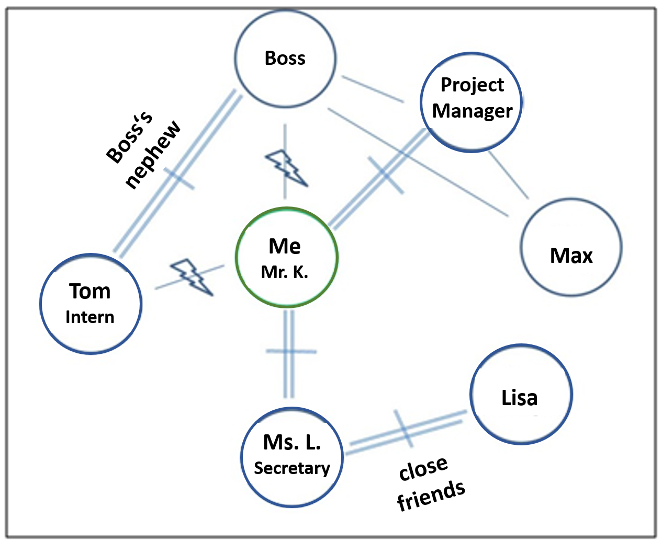
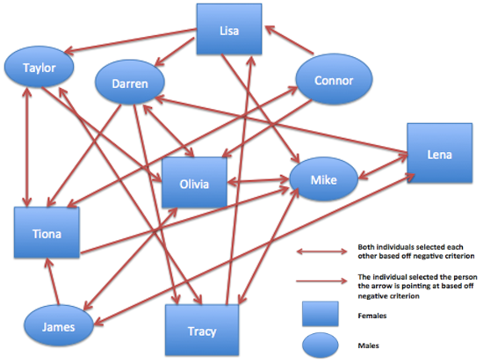
Sociogram (Some examples)

Slide 15

Conflict Diagnosis
- begin by tracking backward
Utilize the foregoing perspective and principles
Identification and analysis of chain reactions and interactions
Elements of Cooperation (find by observation and communication)
Find actions, reactions, and interactions
Seek to discover impressions and misperceptions
Assess what is perpetuating the conflict
Identify system rules that are adding to or sustaining the conflict
Identify who and what benefits from the conflict
Determine what is attained by the conflict that might be attained in an alternative, constructive manner.
Look for patterns, communication gaps, and cause-and-effect relationships

Slide 16
For Negotiation
correctly diagnose the conflict.
To be able to correctly diagnose the conflict, it is necessary
that we recognize our predispositions for dealing with conflict
The propriety of strategy varies with the nature of the conflict, the circumstances, and the individuals involved

Slide 17
References- Images
https://quizizz.com/media/resource/gs/quizizz-media/questions/2b20acb0-206d-416d-8f92-bf39ecc7cbe7
https://th.bing.com/th/id/R.bb705de6ebd2d720396fb598784c0a14?rik=AedAopialsq9Iw&riu=http%3a%2f%2fclipartmag.com%2fimages%2fconflict-clipart-21.png&ehk=SNSJE%2bpHBhs4N0YWrqE%2fH2SsvZH6Gld4Q%2bjnCChH7D4%3d&risl=&pid=ImgRaw&r=0
https://th.bing.com/th/id/R.ca10bc48f0bc86d00e560083d83022fc?rik=sPkdQQdRDUP3AQ&riu=http%3a%2f%2fclipart-library.com%2fdata_images%2f323141.jpg&ehk=270krkp%2bemIlRNmoqwByMY3KgMb%2bgjq7WokLQisTs7A%3d&risl=&pid=ImgRaw&r=0
https://www.google.com/url?sa=i&url=https%3A%2F%2Fwww.landsiedel.com%2Fen%2Fcoaching%2Fsociogram.html&psig=AOvVaw0OXKoZOU9-xGXNfWzv5kFg&ust=1690221112456000&source=images&cd=vfe&opi=89978449&ved=0CA4QjRxqFwoTCLC7-LuypYADFQAAAAAdAAAAABAw
https://i.pinimg.com/originals/31/c5/17/31c5171a460a2fc5b03393811d0356d0.png

Slide 18
References
Conflict Management: A practical guide to developing Negotiation Strategies by Budjac Corvette, Barbara A, First edition. Pearson
The Handbook of Conflict Resolution-Theory and Practice by Morton Deutsch, Peter T. Coleman, Eric C. Marcus, 2nd edition. Jossey-Bass (Wiley Imprint)

Slide 19
THANK YOU

